Slide 1


Lecture 0: Introduction with a bias towards applications
Anish Arora
CIS788.11J
Introduction to Wireless Sensor Networks

Slide 2
Outline
Anatomy of a wireless sensor network (WSN)
State-of-the-art of WSNs
Brief overview of one application context: Project ExScal
More on application contexts
Models
Validation

Slide 3
Anatomy of a sensor(-actuator) node
Application
SENSING
SUB-SYSTEM
PROCESSING
SUB-SYSTEM
COMMUNICATION
SUB-SYSTEM
Processor
ACTUATION
SUB-SYSTEM
POWER MGMT.
SUB-SYSTEM
SECURITY
SUB-SYSTEM
Sensor
(Passive infrared)
Actuator
(Buzzer)
Network
Interface
Attitude: Freely choose physical variable of interest !
Another: Killer apps will multiply when actuation closes the loop

Slide 4
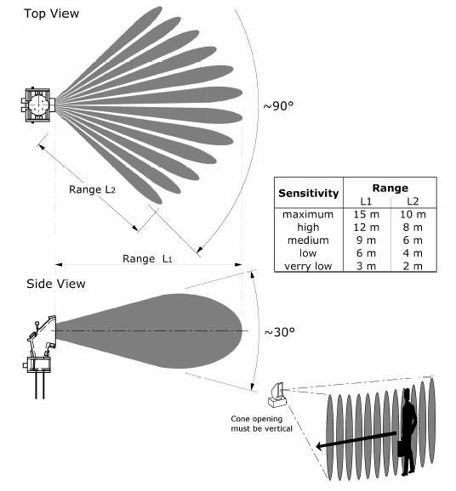
An example of a sensor: Passive infrared
PIR is a differential sensor: detects target as it crosses the “beams” produced by the optic

Slide 5
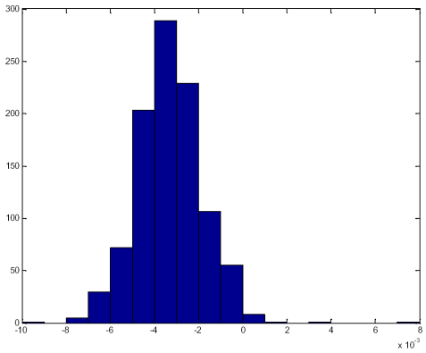
A PIR sensing application
Detect & classify presence of target
Application components
signal conditioning hardware
analog to digital converter
driver
sampler
target detector & classifier
S
N
PDF of Noise
Kurtosis = 2.97

Slide 6
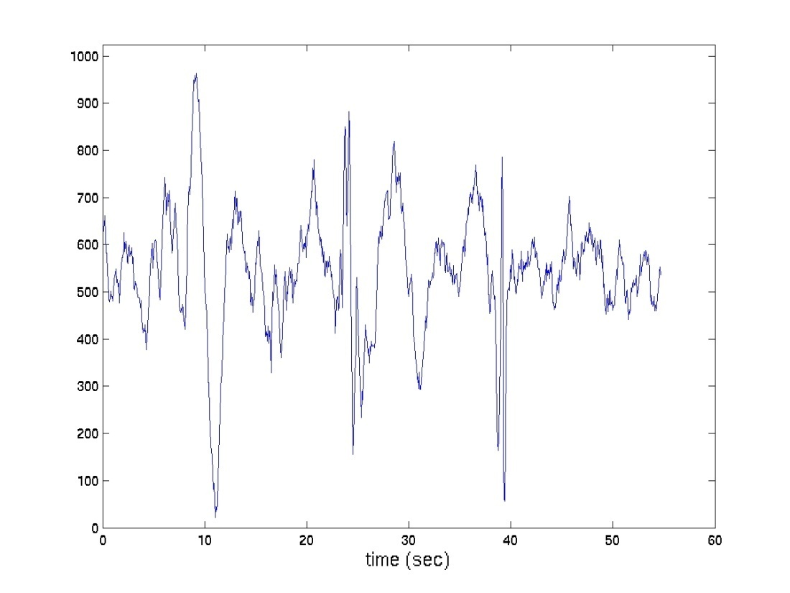
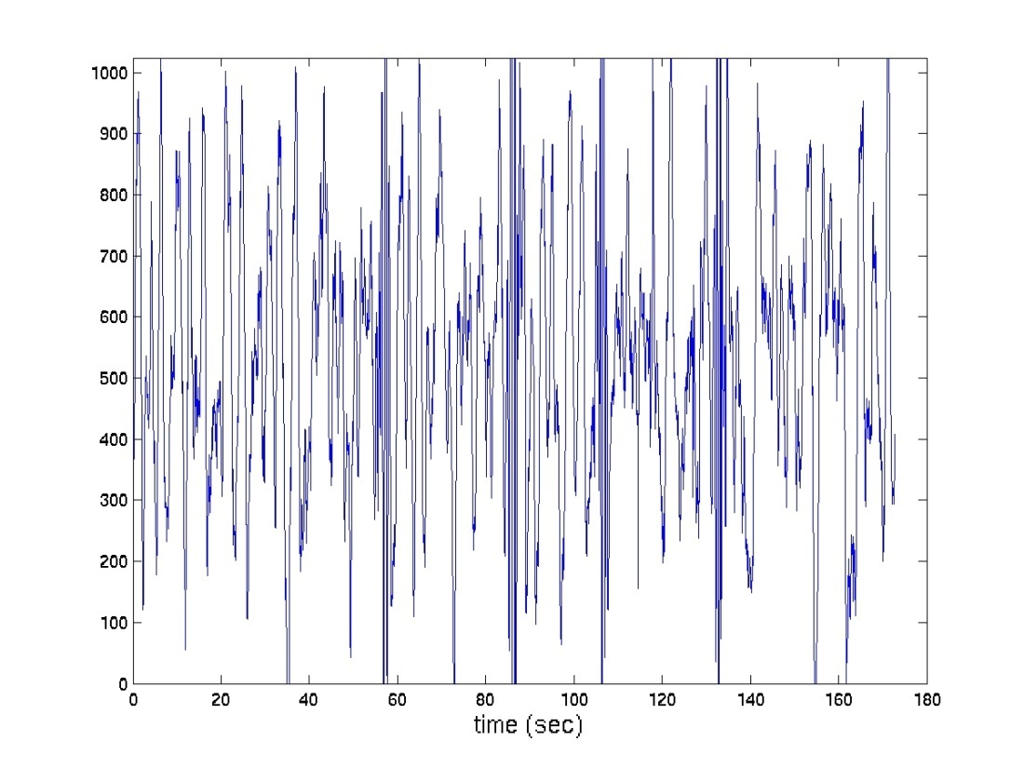
PIR signal: Amplitude
Human
3 mph @ 10m
Car
20-25 mph @ 25m

Slide 7
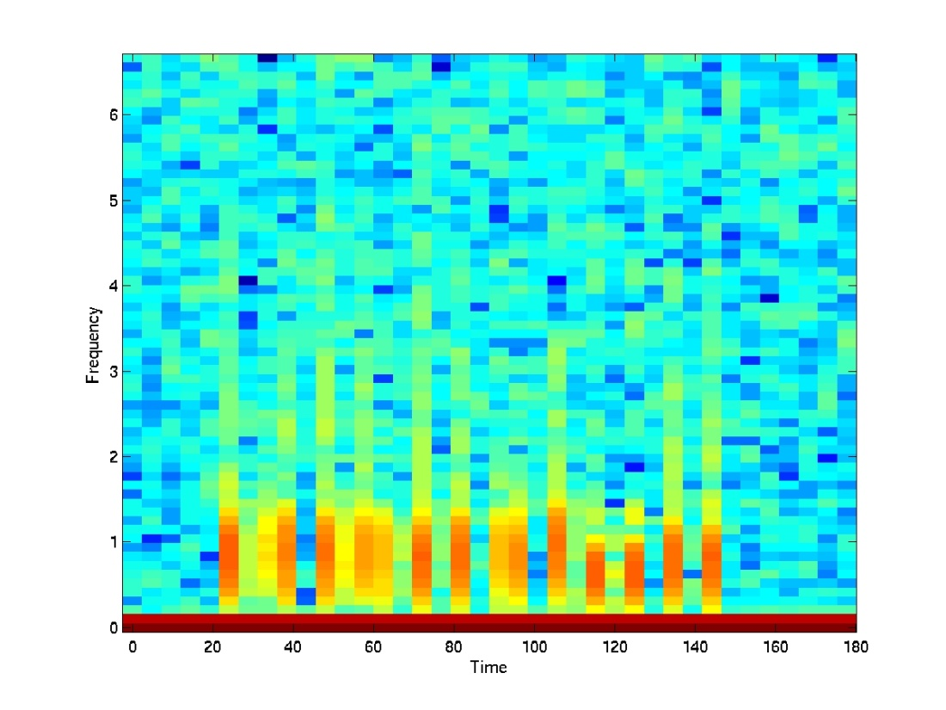
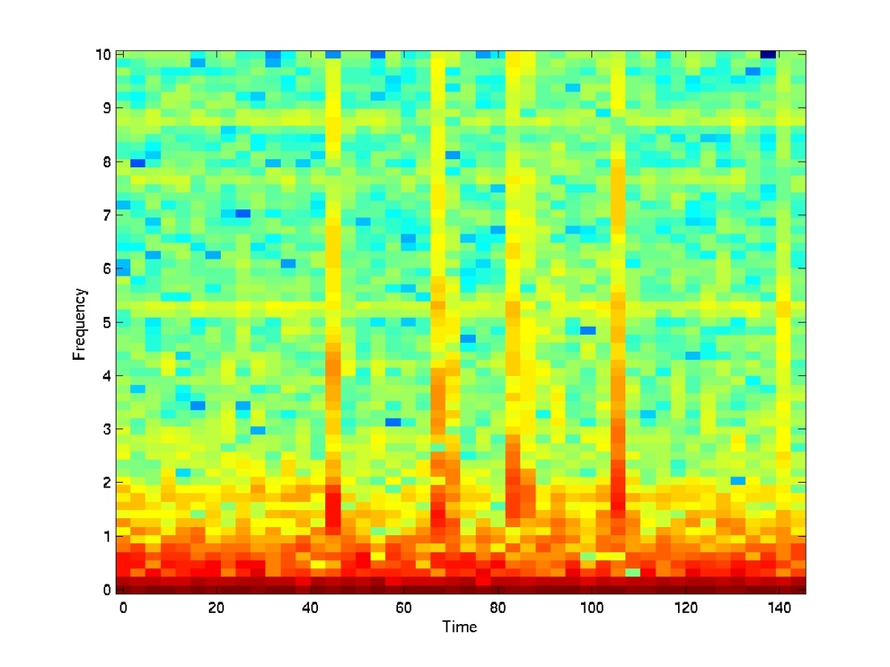
PIR signal: Frequency
Human at 10 m
Car at 25m
Energy content for these two targets is in low frequency band

Slide 8
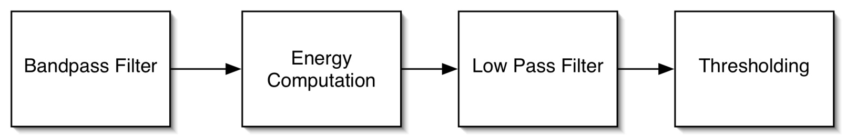
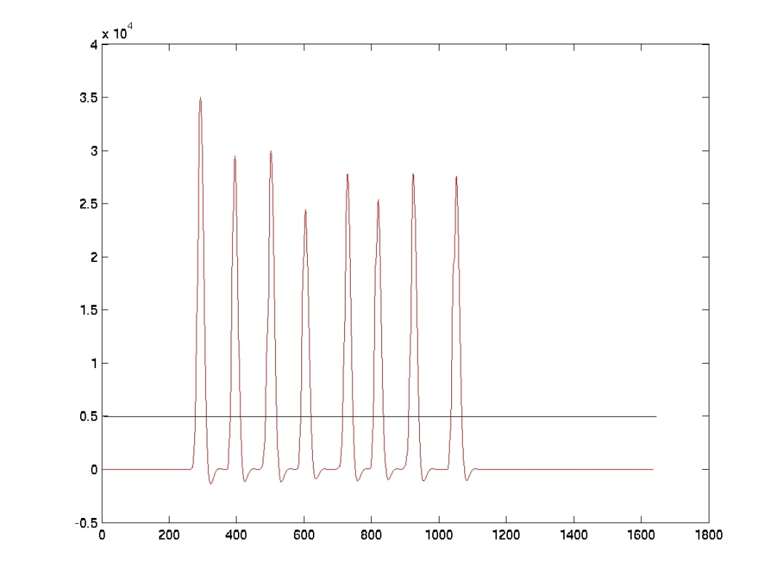
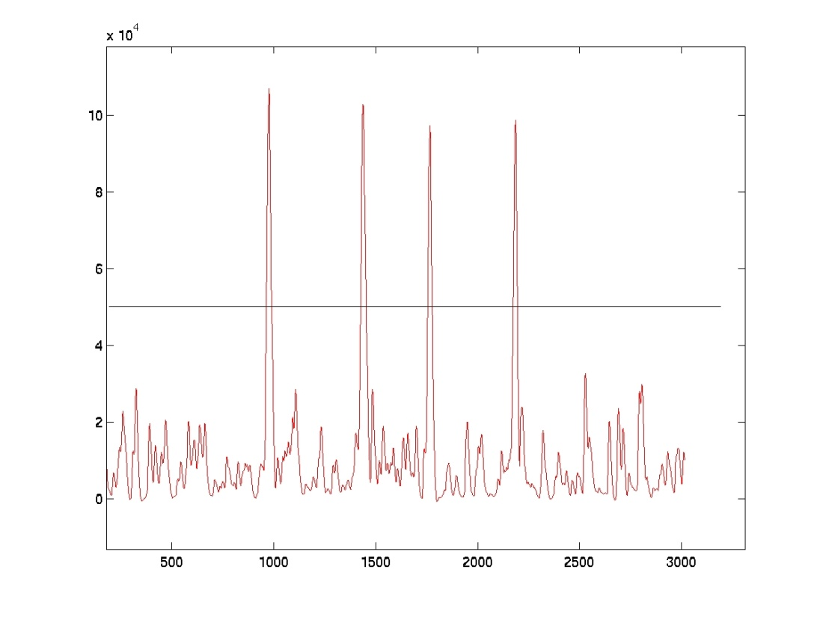
Pir target detector
[0-0.3 Hz]
Person at 12 m
SUV at 25 m
Bandpass: [0.4- 2 Hz]
Bandpass: [2- 4 Hz]

Slide 9
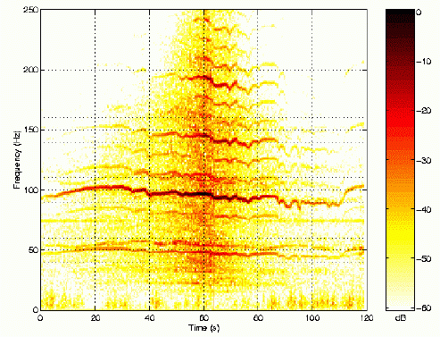
Sensor nodes may be resource rich or poor
Sample concept: characterize targets by a unique, sophisticated time-frequency signature
Resource-rich sensor nodes centrally execute resource intensive algorithm to match signatures; implies focus on signal processing
Resource-limited sensor nodes imply focus on networking & distributed computing
Tien Pham
Notes:
The network is characterized by low resource but
densely arranged nodes. Each node can sense, compute,
and communicate.
In high power SOCOM sensor nodes, such as REMBASS-2, nodes are capable of
executing complex, resource intensive signal processing and control programs to
achieve comparable detection.

Slide 10
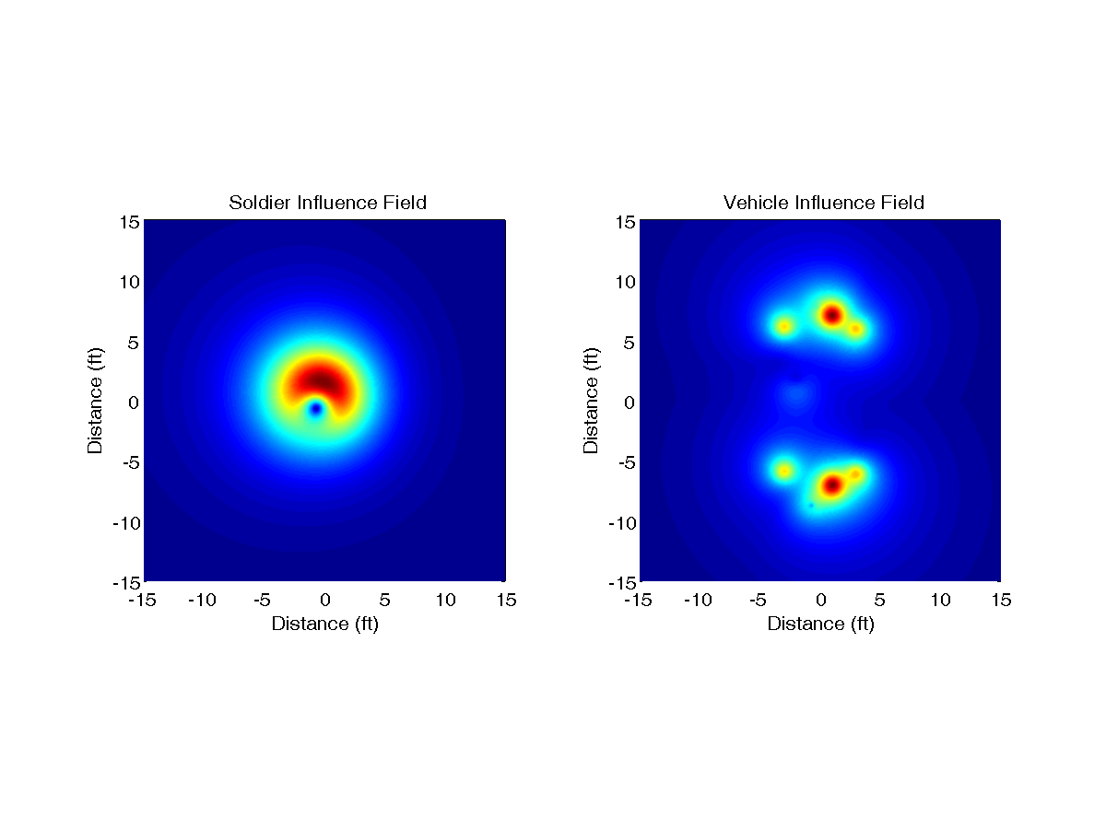
A distributed classification approach
Assume a dense WSN
Concept: each target type has unique influence field
Multiple sensors which detect target coordinate,
potentially each with multiple sensing modalities
Classification is via reliable estimation of influence field size
[Computer Networks 2004]

Slide 11
Outline
Anatomy of a wireless sensor network (WSN)
State-of-the-art of WSNs
Brief overview of one application context: Project ExScal
More on application contexts
Models
Validation

Slide 12
State-of-the-art: A bias towards applications & experiments
Applications focus attention on basic problems:
2002: timesync
2002-3: routing (including bulk dissemination)
2003-4: localization
2004: management
Experiments have been necessary to deal with:
current inadequacy of simulations & formal models
to model variabilities and unreliabilites in a sound way
scaling effects: observations of “phase transitions”,
where components fail at higher scales

Slide 13
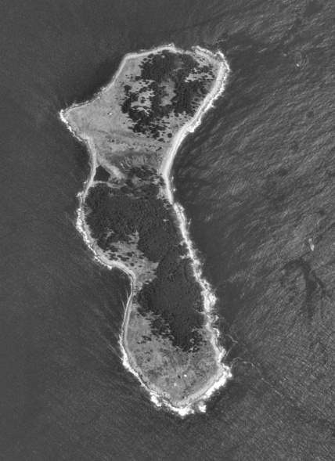
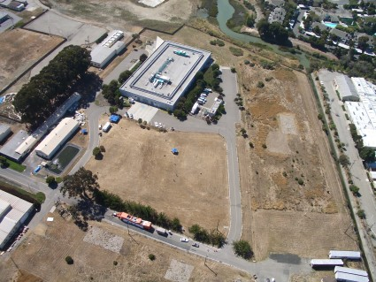
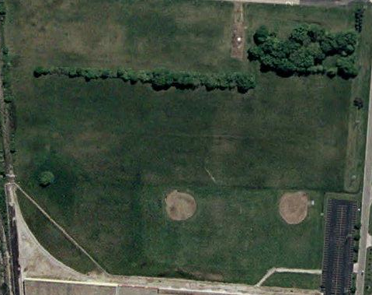
Why Experimentation ?
Lack of validated theoretical models for Sensor and RF signal propagation
Limited capability of simulations in capturing the detailed effects of the deployment environments
Experimentation with current HW/SW platforms

Slide 14
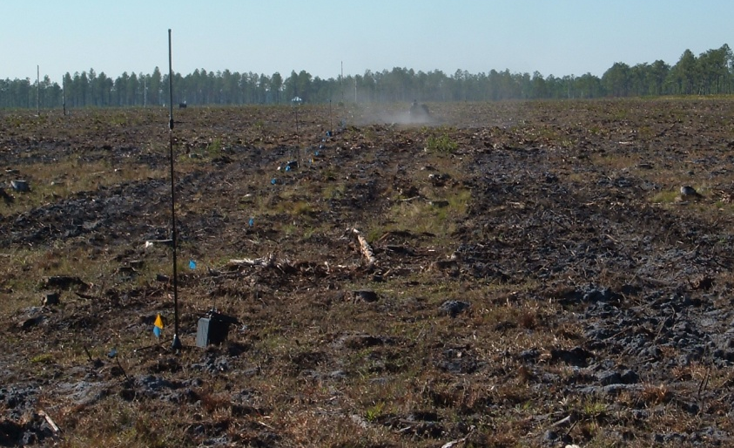
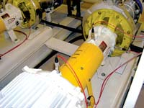
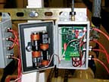
State of research: Field deployments are growing in scale
Intel Developer Forum
ExScal
Intel Hillsboro Fab
Middle America Subduction Experiment
Notes:
Intel Developer Forum, 800 motes, 8 hop network
Middle America Subduction Experiment (MASE) is a collaborative project between California Institute of Technology, Universidad Nacional Autonoma de Mexico (UNAM) and UCLA CENS. The project is instrumenting a 500-km transect from Acapulco to Mexico City to Tampico by installing 100 broadband seismometers located every 5 to 20 km. UCLA has installed almost 50 seismometers covering nearly one-half of the line and is using telemetry technology designed by CENS. The entire line will be operating for at least one full year.
London-based BP outfitted the Loch Rannoch, one of its oil tankers, with 160 motes to measure vibration in the ship’s pumps, compressors and engines, according to The Economist (June 10, 2004).
Intel’s Flanigan reports that they have 210 vibration sensors installed on 40 machines so far, and will eventually equip about 3,000 machines in the giant Hillsboro plant. Each sensor connects to a mote, which provides the wireless connectivity and the I/O interface to the vibration sensor. One advantage of the wireless system is the reduced cost of installation. Flanigan says the cost to equip a machine with six sensors is about $750 for the vibration sensors and about $250 for the motes, a Stargate modem and enclosures, or about $1,000 per machine. To do it with conventional equipment would cost about $8,000 per machine, Flanigan estimates.

Slide 15
Scaling of experimental dense WSNs
Year | Nodes | Area | Program size
2002 | ~10 | ~10 sq. m. | ~5KB
2003 | ~100 | ~500 sq. m. | ~30KB/100KB
2004 | ~1000 | ~250,000 sq. m. | ~200KB/2MB
Concomitant increase in:
component depth and interaction complexity
component unreliability and variability
deployment and manageability complexity

Slide 16
Outline
Anatomy of a wireless sensor network (WSN)
State-of-the-art of WSNs
Brief overview of one application context: Project ExScal
More on application contexts
Models

Slide 17
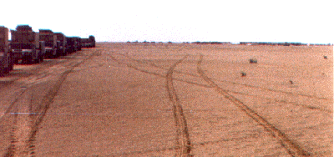

Project ExScal: Concept of operation
Put tripwires anywhere—in deserts, other areas where physical terrain does not constrain troop or vehicle movement—to detect, classify & track intruders [Computer Networks 2004, ALineInTheSand webpage, ExScal webpage]

Slide 18
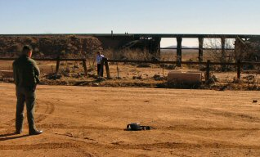
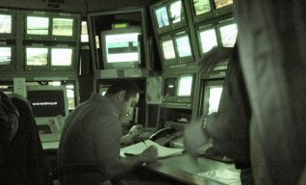
ExScal scenarios
(1) Border Monitoring:
Detect movement where none should exist
Decide target classes, e.g., foot traffic to tanks
Ideal when combined with towers, tethered balloons, or UAVs
(2) Littoral operations:
Submersibles & small boats in littoral regions require proximal sensing
Communication can be acoustic
Good environment for energy harvesting

Slide 19
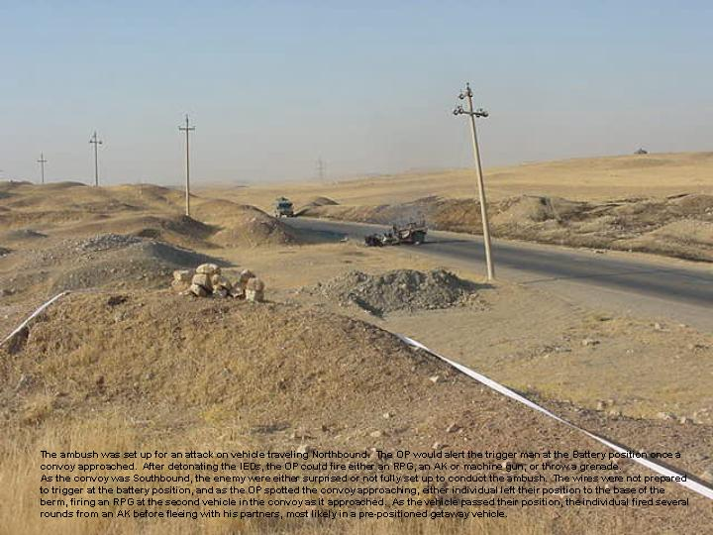
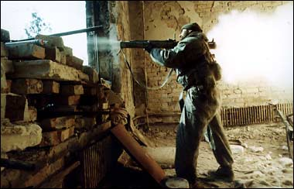
ExScal scenarios (continued)
(3) Construction Detection:
Detect anomalous activity
E.g., cars go by often, but no one should stop or start digging
Requires persistent surveillance and in-network pattern matching
(4) Movement in Tunnels:
The ultimate environment for defeating long range sensing
(5) Urban Operations:
Tactical Situational Awareness
Movement indoors and between buildings
Rapid dissemination to combatants

Slide 20

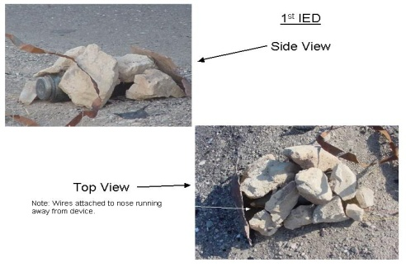
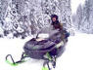
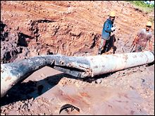
Envisioned ExScal customer application
Convoy protection
Detect anomalous activity
along roadside
Hide Site
IED
Border control
Canopy precludes aerial
techniques
Gas pipeline
Rain forest – mountains – water
environmental challenges
Notes:
(no notes)

Slide 21
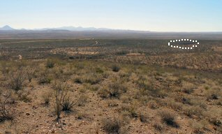
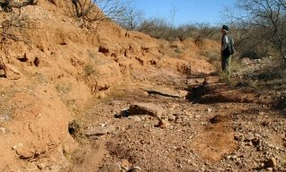
Salient characteristics of ExScal: Coverage
Lowest cost per area came from remote control camera tower
~$100K per tower & ~8 km range
ExScal cost ~$160 per node & ~1000 per sq km, yields about $160K per sq km
Price will drop to $10K per sq km, (soon) but not much below that
In nice terrain camera tower covered most of the area
Even in ideal terrain “the other 5%” is operationally significant

Slide 22
Persistence
Many air-to-ground sensors are optimized for short-duration high-urgency use
Several scenarios however need persistence surveillance
Catching infiltrators, early warning, anomaly detection, etc.
Persistence favors:
Ground based: no moving parts
Ad-hoc configuration: self managing, if need be, “overseed” repair process
Wireless: minimal footprint
Nodes need not be small, but …
ExScal like network well suited for persistent surveillance
Notes:
e.g., JSTARS is expensive on a per hour basis

Slide 23
Capital cost: Important but not key
Sensor cost grows slower than coverage area
Conclusion: buy one really expensive sensor
Not unlike Grosch's (first) Law
CPU cost grows as the square root of CPU performance
Conclusion: buy the biggest computer you can afford
Justified IBM mainframes (’65)
Conclusions no longer valid, but Grosch’s Law still mostly holds
Measure of NRE, not price
Capital costs no longer dominate

Slide 24
ExScal summary
Application has tight constraints of event detection scenarios: long life but still low latency, high accuracy over large perimeter vigilance area
Demonstrated in December 2004 in Florida
Deployment area: 1,260m x 288m
~1000 XSMs, the largest WSN
~200 XSSs, the largest 802.11b ad hoc network
Design, development, integration time: 15 months
Field setup & experimentation time: 2 weeks
Team: ~50 people
Budget: ~$5M, 10,000 nodes manufactured

Slide 25
ExScal sample scenarios
Intruding person walks through thick line
(pir) detection, classification, and fine-grain localization
Intruding ATV enters perimeter and crosses thick line
(acoustic) detection, classification, and fine-grain localization
Person/ATV traverses through the lines
coarse-grain tracking
Management operations to control signal chains, change parameters, and programs dynamically; query status and execute commands

Slide 26
Key issues at extreme scale
For large area, how to achieve :
cost effective coverage ( ⇒ minimum # of nodes)
scale sensing & communication ranges
lower power consumption
efficient coverage
robust, reliable, timely & accurate execution
optimize services for scenario requirement
tolerance to deployment errors & component faults
low human involvement ( ⇒ minimum # of touches, easy operation, monitoring & (re)configuration)

Slide 27
Outline
Anatomy of a wireless sensor network (WSN)
State-of-the-art of WSNs
Brief overview of one application context: Project ExScal
Application contexts
Models
Validation

Slide 28
Emerging applications of WSNs …
… are of many types:
Target Detection, Classification, and Tracking
Pursuer Evader Games
Habitat Monitoring
Building Monitoring
Farm Waste Monitoring
Smart Farming and Irrigation
Asset Management
Health Monitoring (of Humans and Critical Plants)

Slide 29
Specific Examples
Detect submerged targets in a harbor / ocean environment
Detect chemical or biological attacks
Detect forest fires
Detect building fires and set up evacuation routes
Monitoring dangerous plants
Monitoring social behavior of animals in farms and natural habitats
Monitoring salinity of water
Monitoring cracks in bridges
Bathymetry of ocean ground
Space exploration
Tracking dangerous goods
Shooter Localization
Pacemakers for heart and brain
Camera-equipped pills for health diagnostics
Epilepsy monitoring and suppression

Slide 30
Assignment 0 (adopted from Ted Herman)
Your assignment is to read and present in class one sensor network application, as reported in a published paper. Surf the web to find material complementary to my pointers.
The time for your presentation should be less than 8 minutes; use the model of this powerpoint presentation presentApp.ppt.
Before next Tuesday’s class, you'll need to email me your presentation.
Your presentation will let other students know about some sensor network application, so they have an overview without having to read the paper in as much detail as you did.
To prepare the presentation, you likely need’nt master all the details of the paper. Often, though, it can help to find backup technical reports and presentations by the researchers, to help you prepare. Overall, you should spend about four to six hours on this task.

Slide 31
References for Applications Assignment (2009)
Hospital Epidemiology: Wireless Applications for Hospital Epidemiology [ref]
Nericell: Rich Monitoring of Road and Traffic Conditions using Mobile Smartphones [ref]
Participatory sensing in commerce: Using mobile camera phones to track market price dispersion [ref]
The BikeNet Mobile Sensing System for Cyclist Experience Mapping [ref]
Model-Based Monitoring for Early Warning Flood Detection [ref]
NAWMS: Nonintrusive Autonomous Water Monitoring System [ref]
Luster: Wireless Sensor Network for Environmental Research [ref]
Hybrid sensor network for cane-toad monitoring [ref]
SensorFlock: An Airborne Wireless Sensor Network of Micro-Air Vehicles [ref]
Identification of Low-Level Point Radiation Sources Using a Sensor Network [ref]

Slide 32
References for Applications Assignment (2009)
Mobile Sensor/Actuator Network for Autonomous Animal Control [ref]
Detecting Walking Gait Impairment with an Ear-worn Sensor [ref]
Textiles Digital Sensors for Detecting Breathing Frequency [ref]
Recognizing Soldier Activities in the Field [ref]
Physical Activity Monitoring for Assisted Living at Home [ref]
PipeNet: Wireless sensor network for pipeline monitoring [ref]
Turtles At Risk [ref]
Cyclists' cellphones help monitor air pollution [ref]
Clinical monitoring using sensor network technology [ref]
CargoNet: low-cost micropower sensor node exploiting quasi-passive wakeup for adaptive asychronous monitoring of exceptional events [ref]
Monitoring persons with parkinson's disease with application to a wireless wearable sensor system [ref]

Slide 33
References for Applications Assignment (2009)
Expressive footwear, shoe-integrated wireless sensor network [ref]
BriMon: a sensor network system for railway bridge monitoring [ref]
Monitoring Heritage Buildings [ref]
PermaDAQ: gathering real-time environmental data for high-mountain permafrost [ref]
Firewxnet: a multi-tiered portable wireless for monitoring weather conditions in wildland fire environments [ref]
Development of an in-vivo active pressure monitoring system [ref]
Personal assistive system for neuropathy [ref]
Smart jacket design for neonatal monitoring with wearable sensors [ref]

Slide 34
References for Applications Assignment (2006)
Condition Monitoring in Intel Hillsboro Fabrication Plant
or BP’s Loch Rannoch Oil Tanker [ref]
Other BP applications (safety, corrosion detection, empty propane tanks)
Volcano Monitoring
Seismic Monitoring
Landslide Detection
Water Distribution Monitoring and Control (agricultural and sewer)
Water Quality
Water Sense
Lake (Aquatic organism) Monitoring
Cane Toad Monitoring
Neptune Ocean Observatory [ref]
Atmospheric Observatory [ref]
Neon (scope and canonical experiments)

Slide 35
References for Applications Assignment (2006)
SensorScope
SenseWeb
CarTel [ref]
Odor Source Localization
CodeBlue (Health care)
Activity Recognition [ref]
Assisted Living [ref]
Wearable wireless body area networks (Health care)
Adaptive house
PlaceLab and House_n projects
Participatory Sensing
Responsive Environments (Uberbadge)
Lover’s cup context aware

Slide 36
References for Applications Assignment (2005)
SensorWebs in the Wild
Dynamic Virtual Fences for Controlling Cows
Hardware design experiences in ZebraNet
Energy-Efficient Computing for Wildlife Tracking: Design Tradeoffs and Early Experiences with ZebraNet (see also additional background & Zebranet Web Site)
Sensor/actuator networks in an agricultural application (you'll need to search for more on this topic)
http://www.tde.lth.se/cccd/images/CCCD%20Workshop%202004-JMadsen.pdf
www.diku.dk/users/bonnet/papers/PhB-Kuusamu.ppt
Smart-Tag Based Data Dissemination
Sensor network-based countersniper system
A large scale habitat monitoring application
Wireless Sensor Networks for Habitat Monitoring.
Habitat Monitoring: Application Driver for Wireless Communications Technology.
Preprocessing in a Tiered Sensor Network for Habitat Monitoring
Wireless Sensor Networks for Habitat Monitoring
Additional Sensor Network Project Sites: Coastal Observatory, Santa Margherita Reserve, Rockwell: Surveillance, Great Duck Island

Slide 37
References for Applications Assignment (2005)
Dynamic Networking and Smart Sensing Enable Next-Generation Landmines
Flock Control
Adaptive Sampling Algorithms for Multiple Autonomous Underwater Vehicles, Proceedings IEEE Autonomous Underwater Vehicles Workshop Proceedings, Sebasco, ME, June, 2004
Sensor Web for In Situ Exploration of Gaseous Biosignatures
Active visitor guidance system (follow the single reference, using Google, to find more)
Two-Tiered Wireless Sensor Network Architecture for Structural Health Monitoring
Sensor-actuator network for damage detection in civil structures
Meteorology and Hydrology in Yosemite National Park: A Sensor Network Application.
A Survey of Research on Context-Aware Homes.
The Aware Home: A Living Laboratory for Ubiquitous Computing Research
Using Pervasive Computing to Deliver Elder Care
Workplace Applications of Sensor Networks
Cougar Project at Cornell (student projects, which have some slides about a demo)
Contaminant Transport Monitoring
Marine Microorganisms (Adaptive Sampling for Marine Microorganism Monitoring)
A Support Infrastructure for the Smart Kindergarten

Slide 38
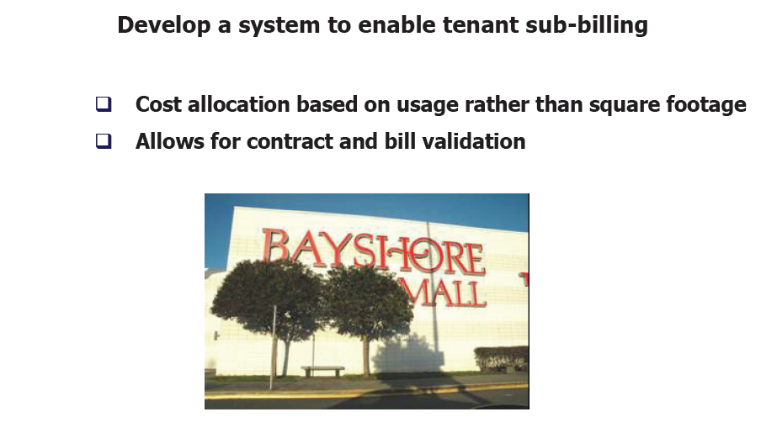
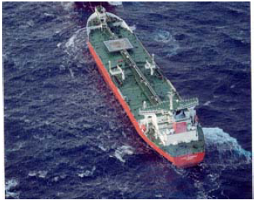
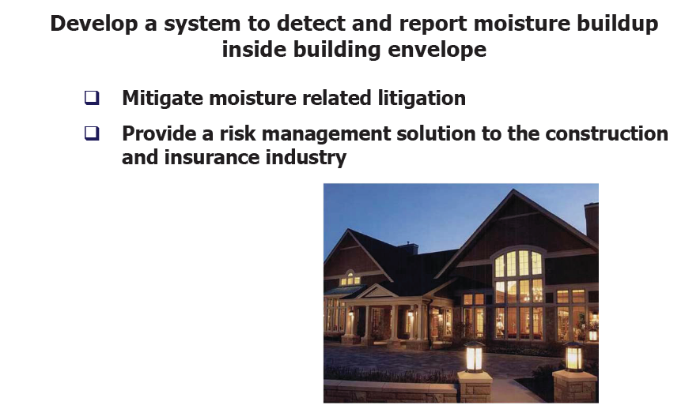
State of the marketplace: Commercial adoption is growing gradually

Slide 39
Required Reading (slides 37-64)
Application Comments from Deborah Estrin
Application Comments from David Culler
Application Comments from Paul Havinga
Other ExScal-like Concept of Operations

Slide 40

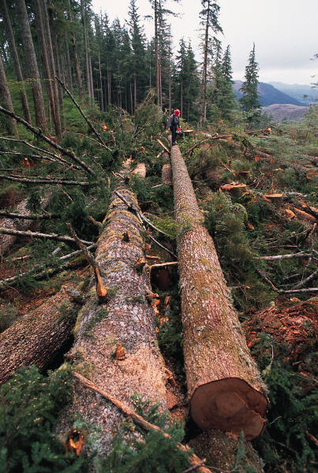
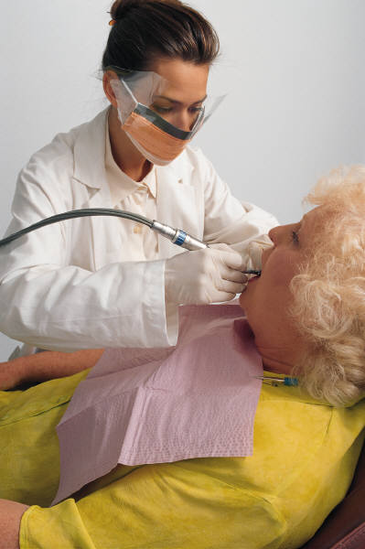
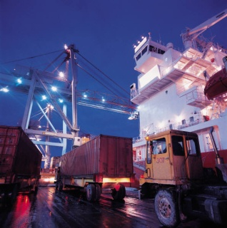
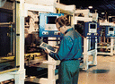

Impacts Key Segments of Society & Economy
Slide courtesy of David Tennenhouse, Intel Research
Health / Life Sciences
Agriculture
Environment
Manufacturing
Distribution
Retail
Notes:
David Tennenhouse from Intel has been a key patron and promoter of this technology, from his earlier days in a funding agency in the US govt and now as VP for research at Intel. He, and intel, are pursuing this technology because of the broad markets envisioned, including those already mentioned as well as public health, patient monitoring, and retail.

Slide 41
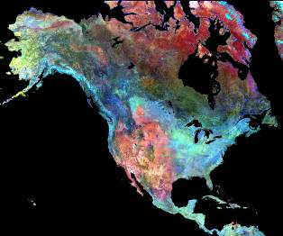
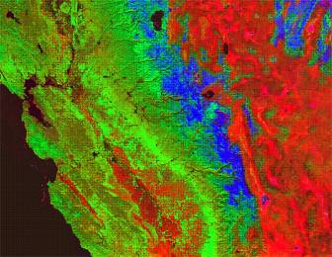
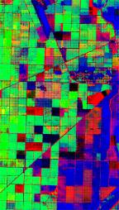
Embedded networked sensing will reveal previously unobservable phenomena
Remote sensing transformed observations of large scale phenomena
In situ sensing transforms observations of spatially variable processes in heterogeneous and obstructed environments
Red: Soil
Green: Vegetation
Blue: Snow
SPOT Vegetation
Daily Global Coverage
SWIR 3 Day Composite
Predicting Soil Erosion Potential:
Weekly MODIS Data
Sheely Farm 2002
Crop map
San Joaquin River Basin
Courtesy of Susan Ustin-Center for Spatial Technologies and Remote Sensing
Notes:
Remote sensing produced tremendous gains for science, governments, and business through its ability to make large spatial scale observations.
However, each pixel in a remote sensing image represents a necessarily large piece of space, and so it does not provide good data or models when there is spatial heterogeneity or obstructions in the environment.
In situ, embedded sensing will transform our ability to observe physical processes at the scale needed to understand and manage environmental issues associated with fine scale dynamics such as precision agriculture, biodiversity, etc.

Slide 42
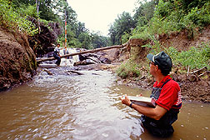
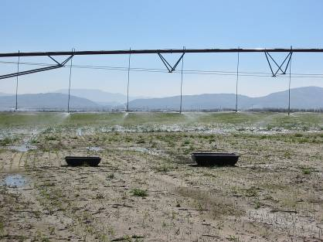

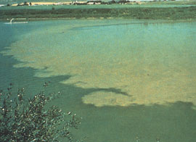
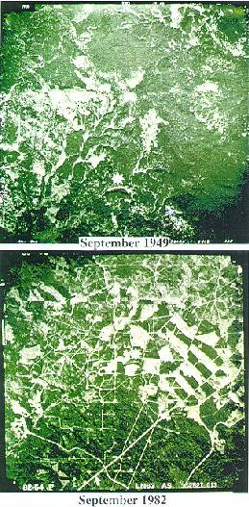
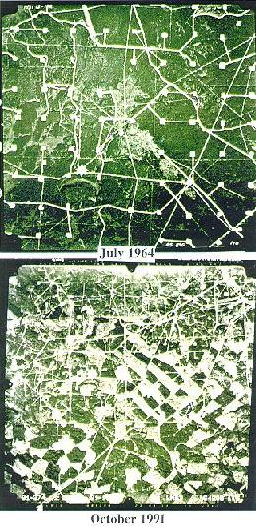
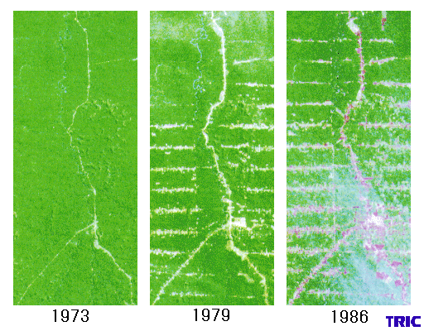
Environmental monitoring applications exhibit high spatial variations and heterogeneity
Overflow of embankment
Precision Agriculture, Water quality management
Algal growth as a result of eutrophication
Impact of fragmentation on species
diversity
Notes:
Many critical environmental processes have high frequency spatial variations and exhibit tremendous heterogeneity
To quote my colleague Dave Caron, Embedded Networked Sensing can provide fine scale information that large scale observations/instruments do not provide, and BIOLOGICAL UNDERSTANDING that only the fine scale gives us.
For example, consider the image in the lower right which provides views to illustrate fragmentation.
Habitat fragmentation has a strong impact on biodiversity and ecosystem
processes by reducing breeding population sizes and altering microclimate
along habitat "edges". To develop predictive models that can forecast biological events we must make measurements at appropriate time and space scales!

Slide 43
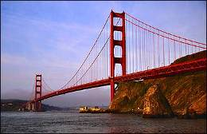
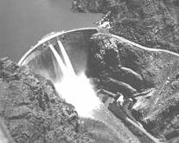
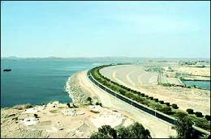

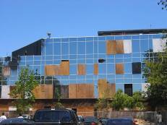
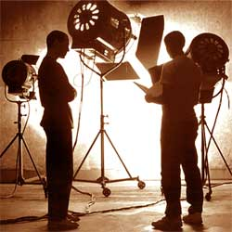
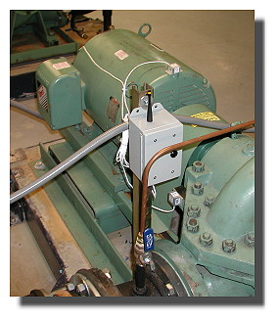
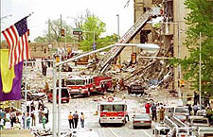

Engineering, civilian, enterprise applications will eventually dominate
As the technology matures we will find wide-reaching applications in the built environment and throughout the business enterprise.

Slide 44







Safe drinking water
Small scale interactions matter
Hypothesis Shallow well depth interactions with local agriculture practices resulted in released arsenic
Prevention and response to natural disasters
Flood:
First Responders:
Mississippi Flood Plain ‘93
Oklahoma City bombing
Courtesy of Jennifer Ayla Jay

Slide 45

Structural integrity modeling and monitoring
Akashi Bridge - Japan
Golden Gate Bridge – San Francisco
A thin arch dam - Switzerland
Condition based maintenance
Intel Research

Slide 46




Pervasive observation in the public sphere
Transparency Visibility
Privacy Reframed
Design versus Regulation
Courtesy of Dana Cuff - Institute for Pervasive Computing and Society
Notes:
-public policy for guidance and control
-restrictive practices
-setting of standards
-part of larger cultural, ethical, and
legal context
-emphasis on individual balanced by group and society
-focus on protection balanced by design

Slide 47
Many technical and policy challenges ahead
How will we monitor the monitors?
Embeddable sensors
Multi-scale data fusion
Trustworthy, autonomous, distributed systems
Notes:
MONITORING THE MONITORS: And as we do move to the built environment and the public sphere it will become critical to take on the question of how we will monitor (validate, calibrate, trust) the monitoring systems themselves.

Slide 48



Broad relevance to global issues requires commitment to multidisciplinary experimental research
Civil Infrastructure
Security
Global Climate Change
Precision Agriculture
Wildfire Management
Public
Health
Water
Quality
Coral Reef Health
Early Warning, Crisis Response
Global Seismic Grids/Facilities
Notes:
technology is never a panacea but hopefully we can put it to work to protect more of the planettie it back that having the data is not enough, need to have the institutional/.political infrastructure in place to put it to work….fix words
To realize the vision we need commercial development of the technology…which is also an opportunity for economic growth

Slide 49
Application Comments from Dave Culler

Slide 50





Revolutionary Applications
Monitoring Space – the Macroscope
Environment Monitoring, Conservation biology, ...
Precision agriculture,
Building comfort & efficiency, HVAC ...
Alarms, security, surveillance, treaty verification ...
Vineyards
BC
Intelligent Alarms

Slide 51



Example: Redwood Microclimates
70% of H2O cycle is through trees, not ground
Can only observe top surface of the forest
Need to understand what happens within the trees
Berkeley/SF

Slide 52




Wireless Micro-weather ‘Mote’
Incident Light Sensors
TAOS total solar
Hamamatsu PAR
Mica2 “dot” mote
Power board
Power supply
SAFT LiS02 battery, ~1 Ah @ 2.8V
Weatherproof Packaging
HDPE tube with coated sensor boards on both ends of the tube
O-ring seal for two water flows
Additional PVC skirt to provide extra shade and protection against the rain
Radiant Light Sensors
PAR and Total Solar
Environmental Sensors
Sensirion humidity + temp
Intersema Pressure + temp
mote
battery

Slide 53


Dense Self-Organized Multihop Network

Slide 54

10m
20m
34m
30m
36m
Bottom
Top
2003, unpublished

Slide 55






Revolutionary Applications
Monitoring Spaces
Env. Monitoring, Conservation biology, ...
Precision agriculture,
built environment comfort & efficiency ...
alarms, security, surveillance, treaty verification ...
Monitoring Things
condition-based maintenance
disaster management
urban terrain mapping & monitoring
Earthquake Response, Glaser et al.
Wind Response
Of Golden Gate Bridge
Condition-Based
Maintenance
14
5
`
15
Intel Research
13
6
15
12
11
9
8

Slide 56











Example: Equipment Health Monitoring in Semiconductor Fab
Equipment failures in production fabs is very costly
Predict and perform preemptive maintenance
Typical fab has ~5,000 vibration sensors
Pumps, scrubbers, …
Electricians collect data by hand few times a year
Sample: 10’s kilohertz, high precision, few seconds
Fab Equipment
Intranet
Intranet isolation
Root Node
Ad Hoc Mote Network
802.11 Mesh
Mote + Vibration Sensors

Slide 57




Revolutionary Applications
Monitoring Spaces
Env. Monitoring, Conservation biology, ...
Precision agriculture,
built environment comfort & efficiency ...
alarms, security, surveillance, treaty verification ...
Monitoring Things
condition-based maintenance
disaster management
urban terrain mapping & monitoring
Interactive Environments
Ubiquitous computing
handicap assistance
home/elder care
asset tracking
Integrated robotics
CENS.ucla.edu

Slide 58






Interactions of Space and Things
ElderCare
Sensor Augmented
Fire Response
Clinical
Management
Emergency Response
Manufacturing
Asset Management
Harvard/BU CodeBlue

Slide 59

Comments from Paul Havinga

Slide 60

Comments from Paul Havinga

Slide 61

Comments from Paul Havinga

Slide 62

Comments from Paul Havinga

Slide 63

Comments from Paul Havinga

Slide 64
Comments from Paul Havinga

Slide 65
Examples of other military Concept of Operations: Shooter localization

Slide 66

Shooter localization
Red globe:
Shooter position
Light blue sphere:
Sensor node with good measurement
Dark blue sphere:
Sensor node with no (or unused) measurement

Slide 67
Red force tagging

Slide 68
Outline
Anatomy of a wireless sensor network (WSN)
State-of-the-art of WSNs
Application contexts
Comments from Deborah Estrin and Dave Culler
Brief overview of one application context: Project ExScal
Models
Validation

Slide 69


Diverse models
Static
Sensor Node
Cable
NIMS
Node
NIMS
Node
Cable
Intruders
Sensor
Sensor
Sensor
Sensor
Microserver
Sensor Node
Package
Microserver
Sensor Node
Package
WSN
Pursuers
Dense coverage with static nodes or with mobile nodes
Sparse coverage with mobile nodes
Hybrid models:
Static sensor nodes support the mobile node applications
Mobile nodes support communication for sparsely placed static clusters

Slide 70
Validation via Testbeds
Domain Testbeds:
NIMS at James Reserve, Merced Basin and Wind River
Sonoma Redwood Forest and Great Duck Island
WISDEN testbed for structure health monitoring
Platform Testbeds:
MoteLab (Harvard)
MistLab (MIT)
Gnomes (Rice)
Wireless Comm Testbeds:
ORBIT, Roofnet (MIT)
Simulators: EmStar (UCLA)
End-to-end testing: Kansei (Ohio State)

Slide 71
Kansei
Kansei Goals:
Enable end-to-end testing of sensor network applications at scale
Advance “testbed-science” by developing and validating methods for scaling, high fidelity sensor signal generation, multi-tier application management, health monitoring and hybrid simulation
Kansei Principle of Operation:
Experiment with domain arrays large enough to capture sensing / radio phenomena at the required resolution for high fidelity scaling
Test applications at the generic platform array with the captured model of the application environment

Slide 72







Kansei Today: Multiple WSN Fabrics
Stationary Array
PeopleNet
Dreese Sensor Array
Occupancy
Elevator
Temperature
Anchor Nodes

Slide 73










Kansei Roles (I)
Validate systems at-scale
multi-array applications
debugging
predictable performance
Regression testing
injecting different sensor datasets
compare performance of algorithms
Modeling, discovery of phenomena
test applications using different datasets
signal chain
flat, paved lot grassy, bushy ground

Slide 74








Kansei Roles (II)
Location-specific sensing
People-centric networking apps
Mobility testbed
Mobile sensing (planned): NO_{X},CO
+
=

Slide 75
Kansei Roles (III)
Experimentation/application interaction services
code deployment
scheduling
health
injection, exfiltration
frequency, key management
Integrated development environment
diverse object, source, and high-level language input
tools for visualization, simulation, etc.

Slide 76


Kansei
Acoustic & Seismic
Environmental
Generic Platform Array
Multimodal
Mobile
Kansei couples a generic platform array with multiple domain sensing and communication arrays

Slide 77


Elements of Kansei Stationary Array
Heterogeneous testbed with 3 platforms
Stargates
XSM
Telos SkyMote
Stargates provide resources for local computation, storage, data logging and back-channel communication
Four networks:
CC1000-433 MHz, 802.11b
CC 2420-802.15.4, 100 Base-T Ethernet
4 Sony Cameras Pan-Tilt-Zoom, 736x480 Pixel Frame Capture over Ethernet

Slide 78

Elements of Kansei Scaling the communication network
802.11b scaling studies [WinMee 06]

Slide 79
Elements of Kansei Portable Arrays
100 XSM Nodes
Acoustic, Passive Infrared, Magnetometer sensors
60 UCB Trio Nodes
XSM Sensors+ Telos SkyMote + Solar Power Charging
Sensor data collection in deployment environment
Time synchronized data capture
Collection of target signatures & background
noise
Recording of Spatial and Temporal data

Slide 80
Elements of Kansei Mobile Elements
Four Acroname Garcia Robots integrated with XSM+Stargate Pair
Transparent Plexiglas mobility surface
Firmware-C API for motion control
Rotate [A,V], Move [D,V] primitives
Constant velocity, variable direction mode and docking capabilities are being developed in collaboration with Acroname
Simple Localization Service through Connectivity

Slide 81
Software Services-Director
Kansei Director is a set of software services designed to enable end-to-end experimentation
Testbed functions are exposed to the users via service components
Director exposes these services through the Web Interface
Director components are maintained at all tiers (nodes, stargates, servers)
Code Deployment
Scheduling
Job Control (Stop, Suspend, Resume, Move)
Orchestration (Multi-phase jobs)
Testbed Health State
Injection
Data and Experiment Status
Frequency and Key Management

Slide 82

Web Interface

Slide 83
Sensor Data Generation

